Slide 1
MySQL
Setup and Installation

Slide 3
Sign in to your Oracle Account

Slide 4
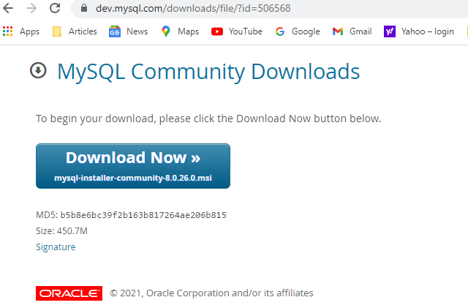

Slide 5
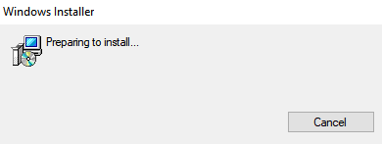
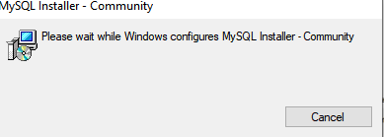
Double Click .msi installer

Slide 6
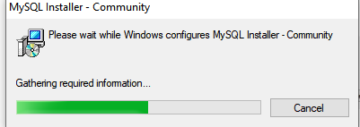
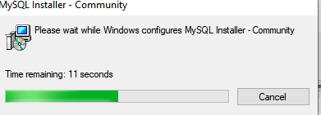
Allow the installation to proceed

Slide 7
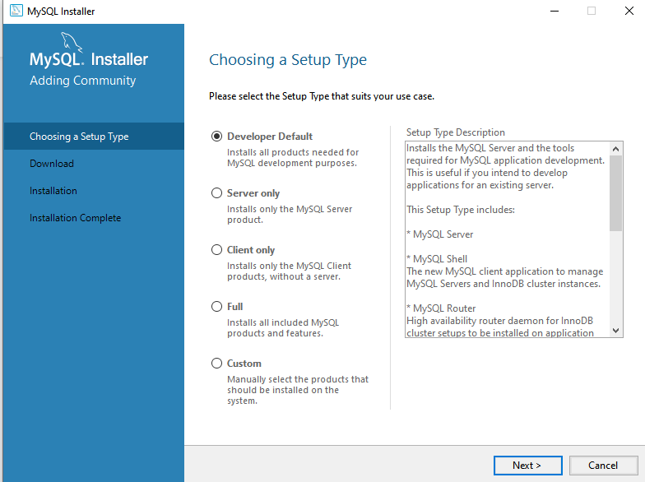
Choose ‘Developer Default’

Slide 8
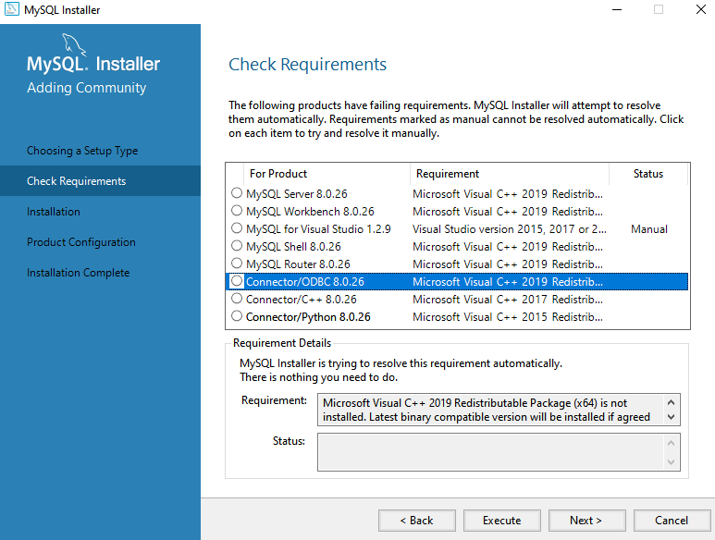
Check Requirements

Slide 9
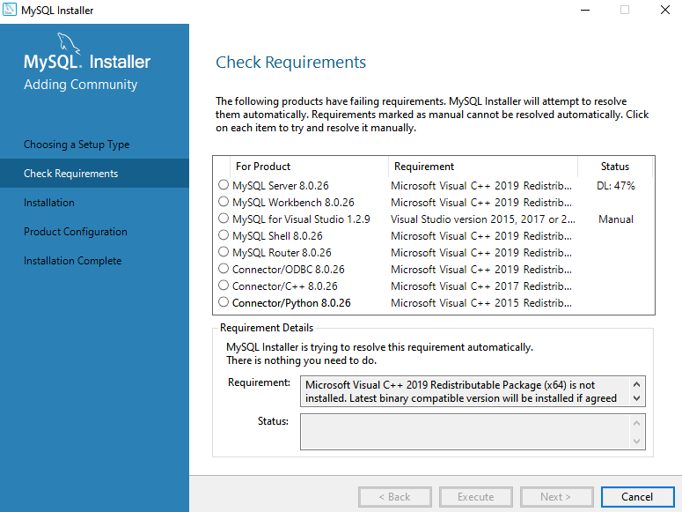
Press Execute to install Requirements

Slide 10
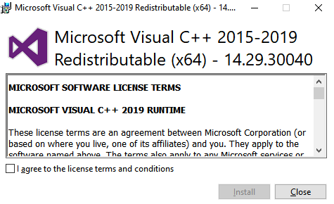
Agree to the license terms

Slide 11
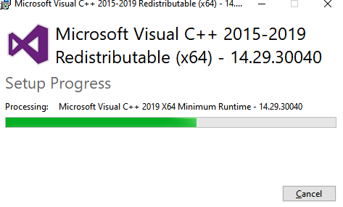
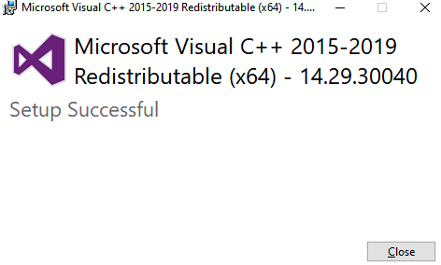
Installation of requirements should proceed

Slide 12
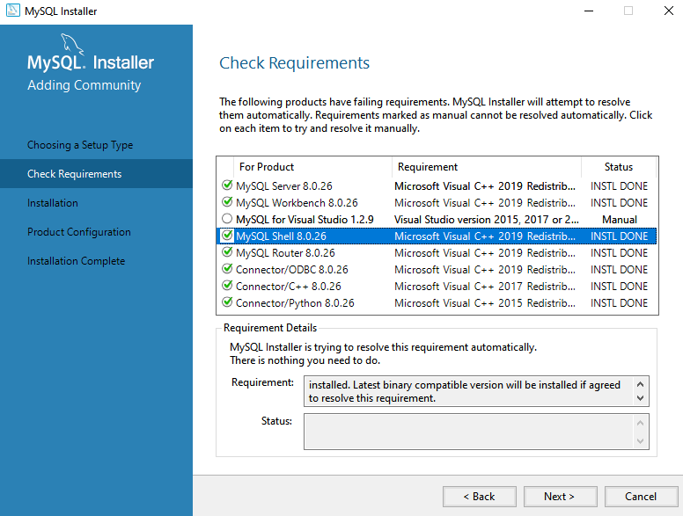
Installation Completes for Each Reuirement

Slide 13
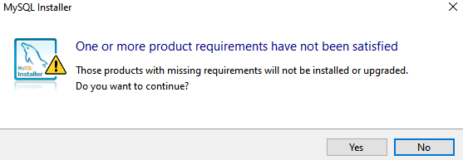
Press ‘Yes’ if only the Visual Studio Requirement has not been satisfied

Slide 14
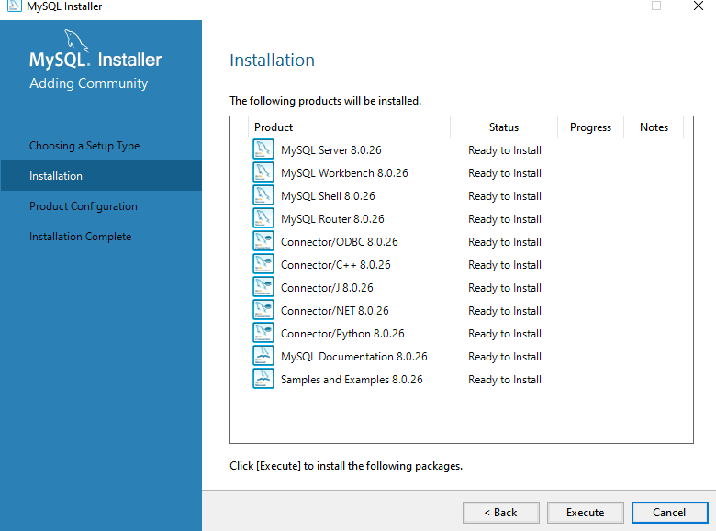
Press Execute to install the listed packages

Slide 15
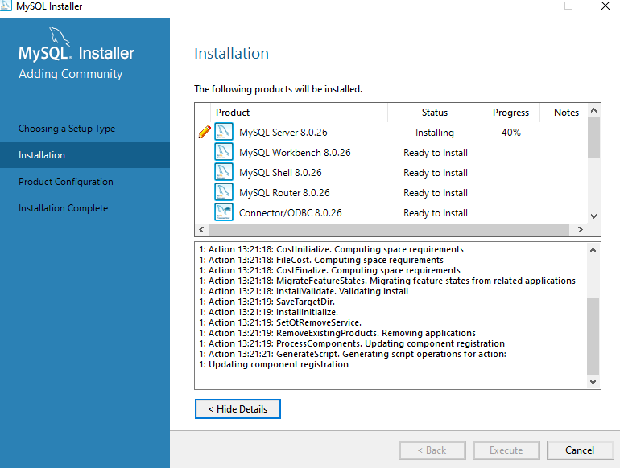
Packages being installed

Slide 16
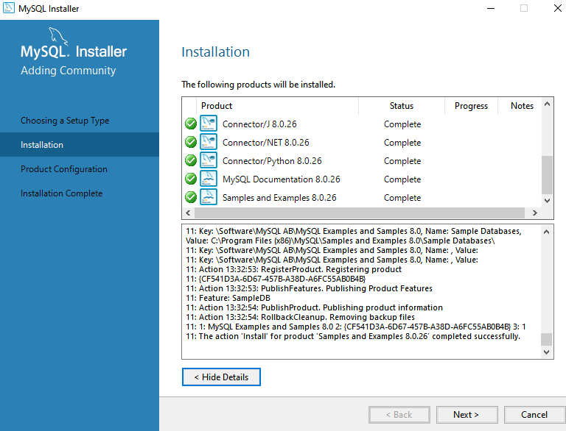
Press Next for Product Configuration

Slide 17
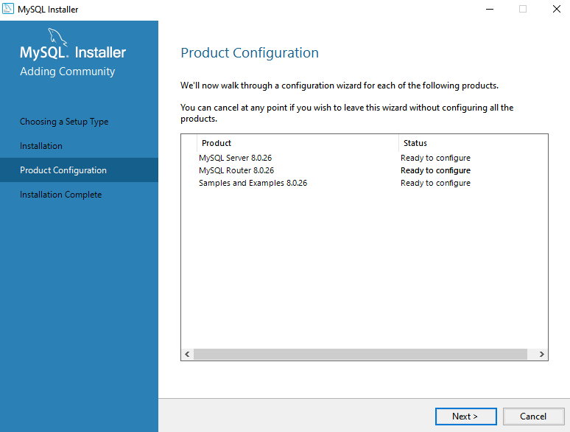
Product Configuration Screen

Slide 18
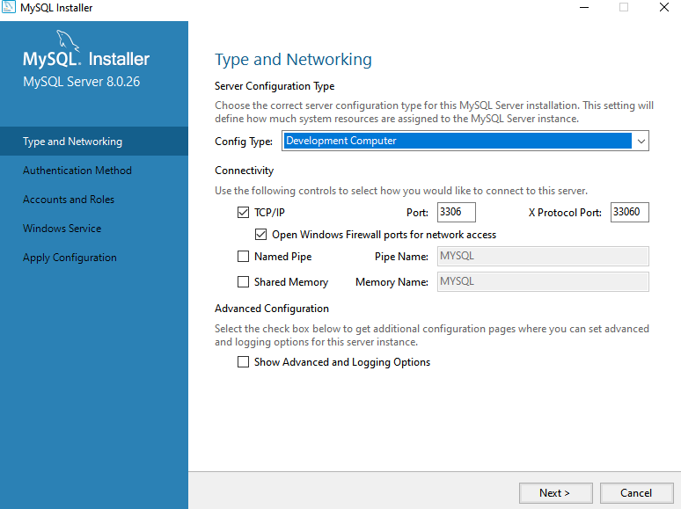
Leave the Defaults

Slide 19
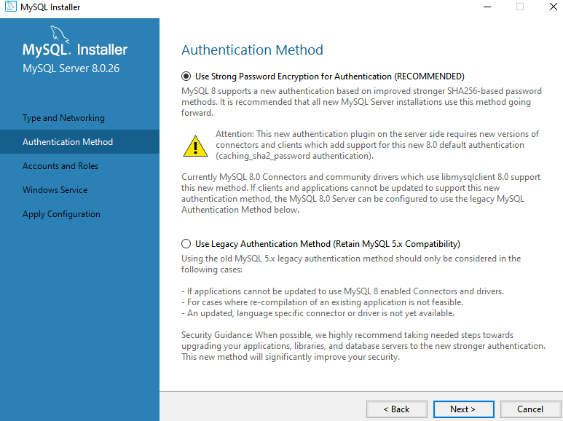
Choose Recommended Authentication Method

Slide 20
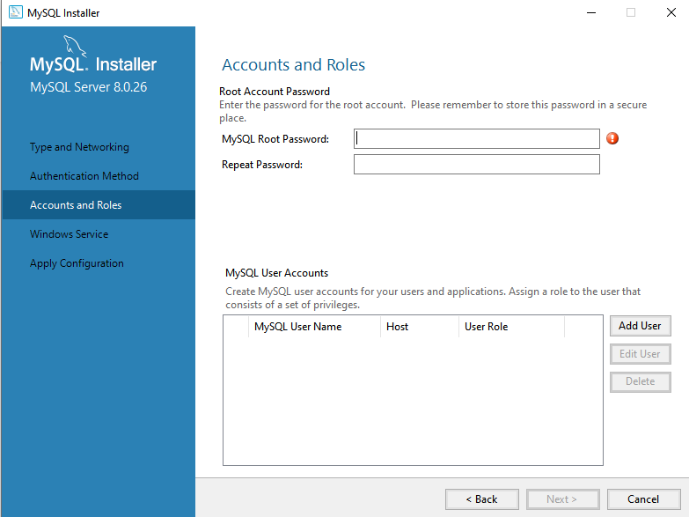
Set Your Root password

Slide 21
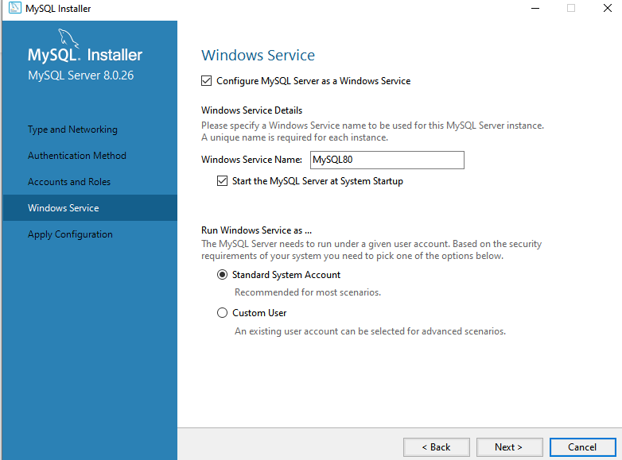
Choose the Defaults to prevent start up issues

Slide 22
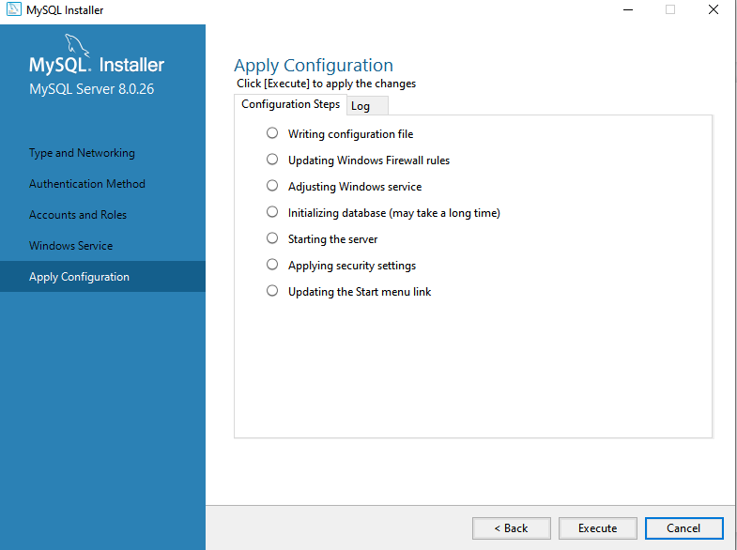
Click Execute to Apply Configuration

Slide 23
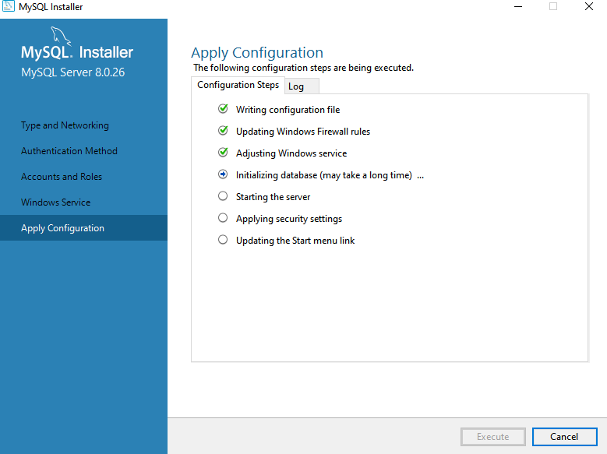
Applying Configuration

Slide 24
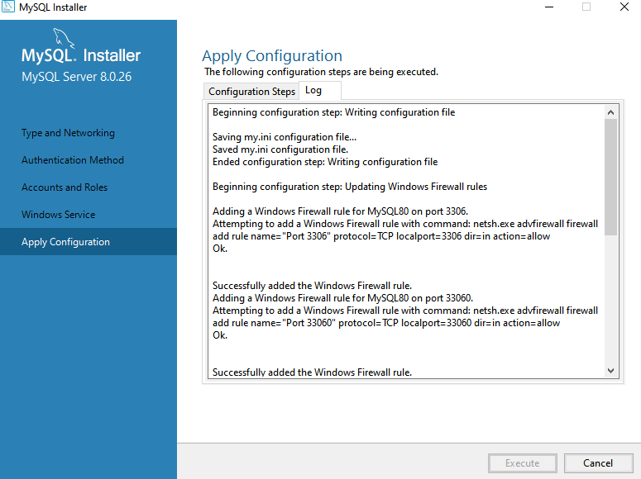
The Log of the Configuration

Slide 25
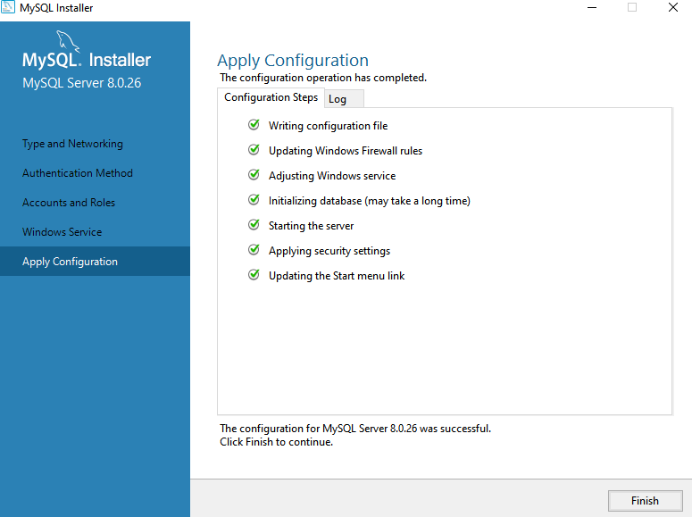
Configuration is Successful!!

Slide 26

Product Configuration

Slide 27
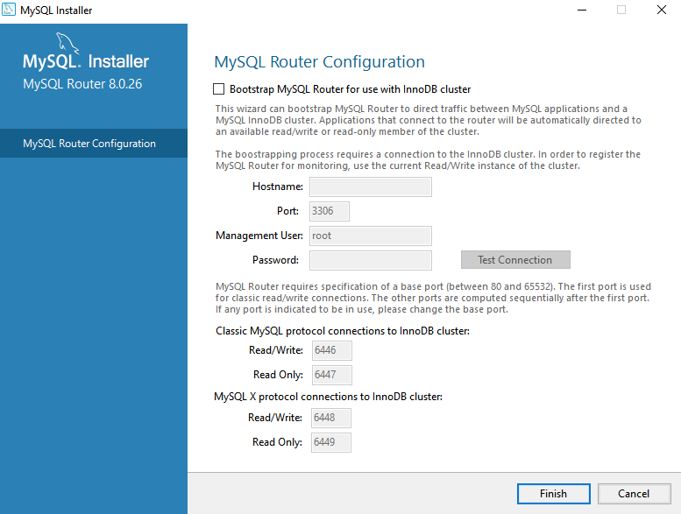
Click Finish

Slide 28
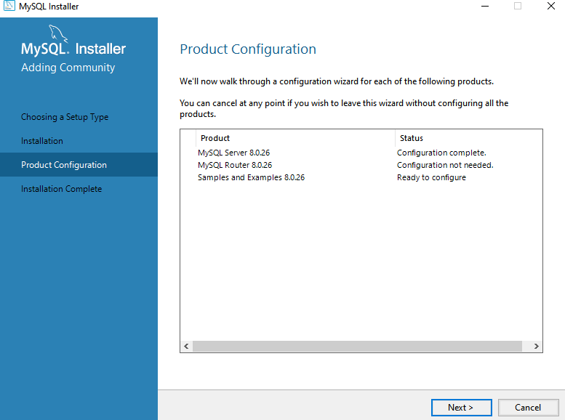
Configure ‘Samples and Examples’

Slide 29
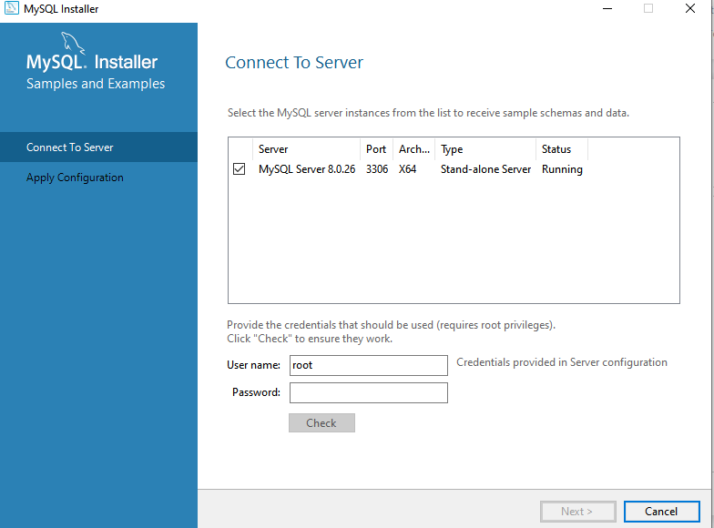
Enter Password for root

Slide 30
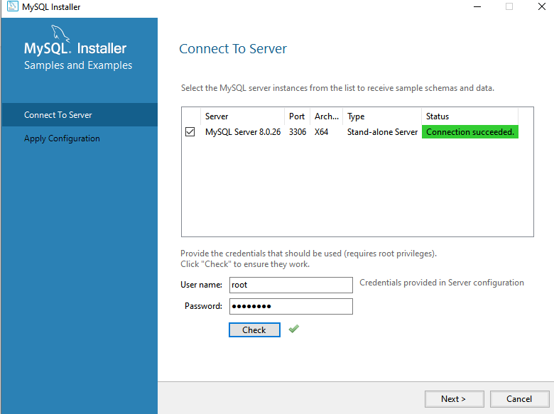
Check Connection

Slide 31
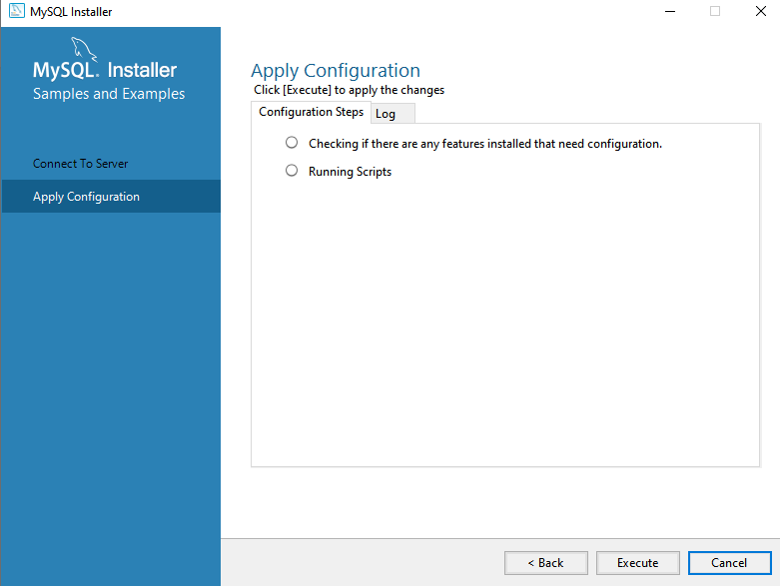
Click Execute to apply Configuration for ‘Samples and Examples’

Slide 32
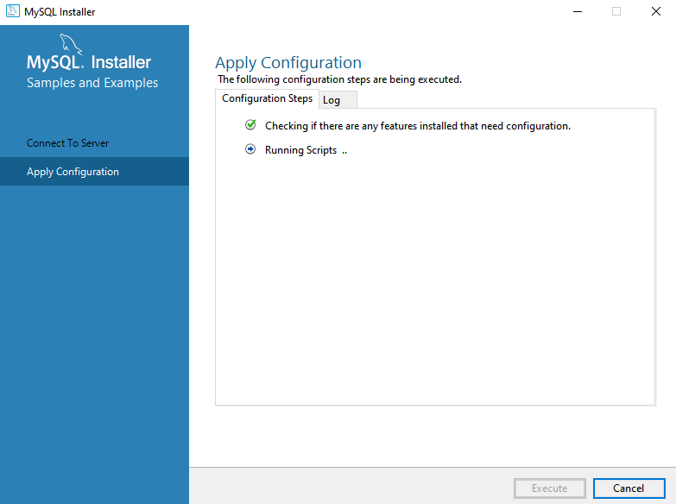
Scripts being run

Slide 33
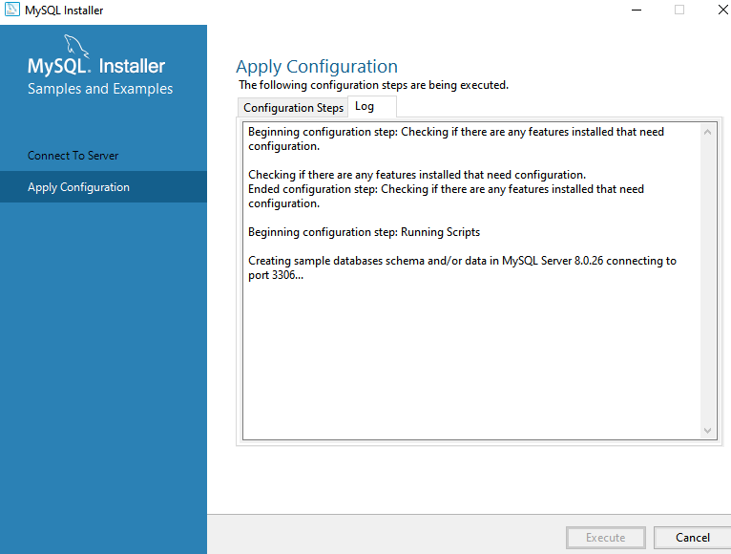
Sample Database Schema/Data being created

Slide 34
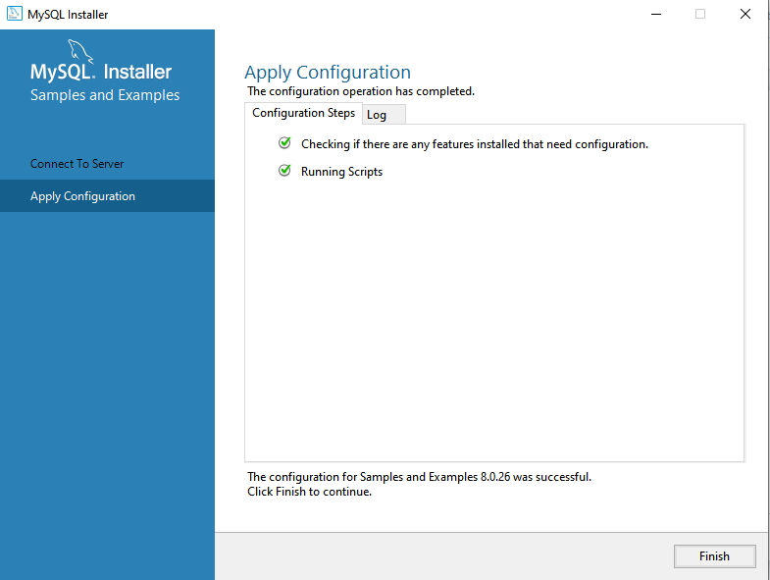
Configuration completed

Slide 35
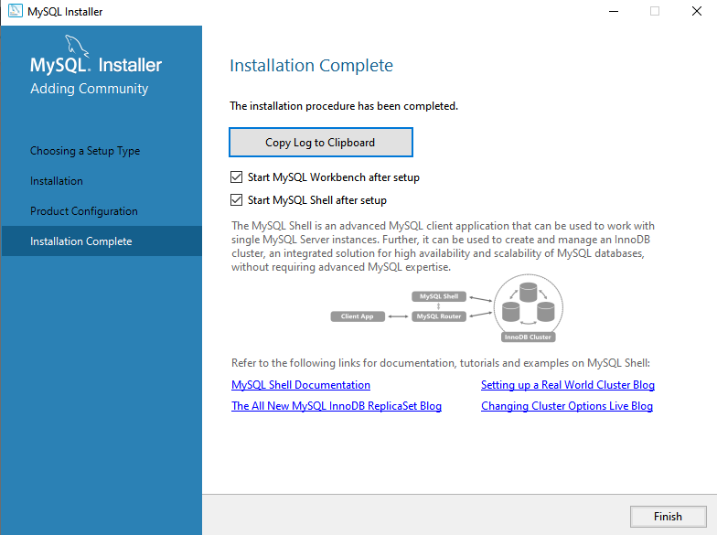
Success!! Installation Complete!! Press Finish.

Slide 36
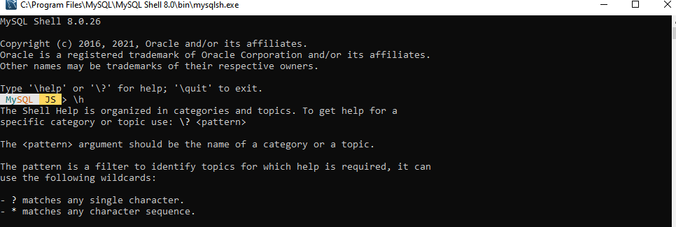
MySQL Shell starts up

Slide 37
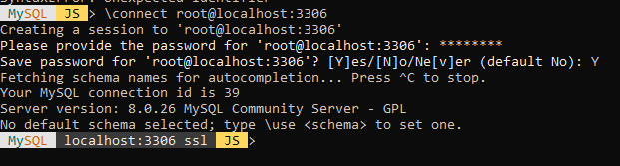
Connect to MySQL from MySQL Shell

Slide 38
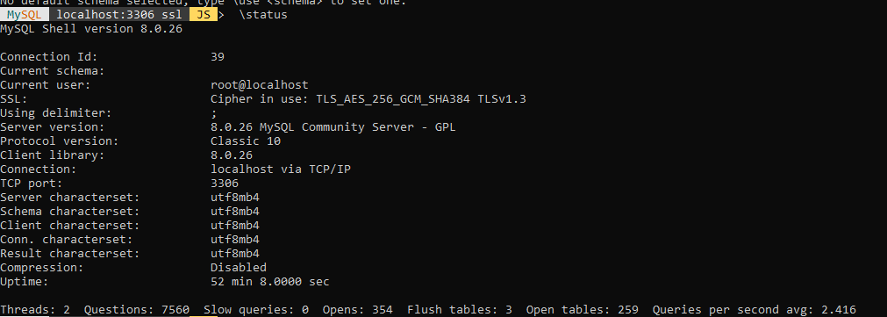
Check Status

Slide 39
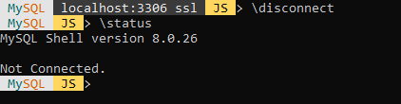
Disconnect the global session.

Slide 40
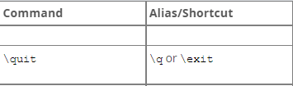
Exit MySQL Shell

Slide 41
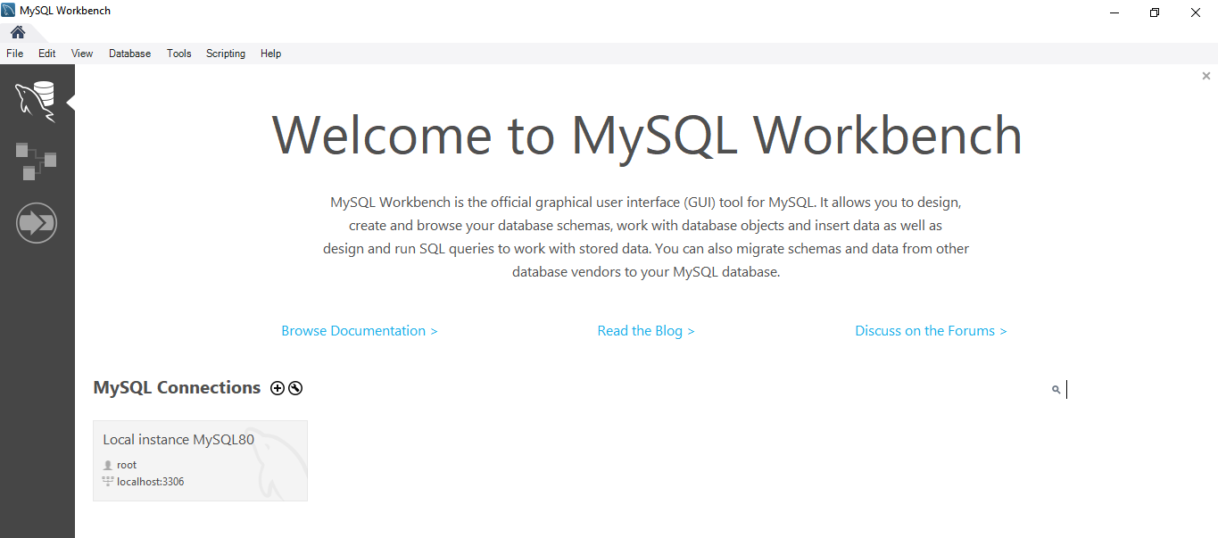
MySQl Workbench starts up

Slide 42
Create a Database Connection

Slide 43
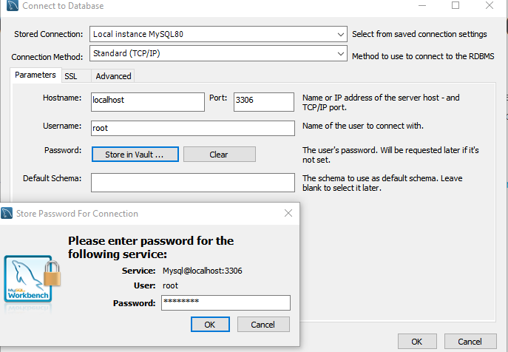
Choose Local instance from dropdown and Store password in Vault

Slide 44
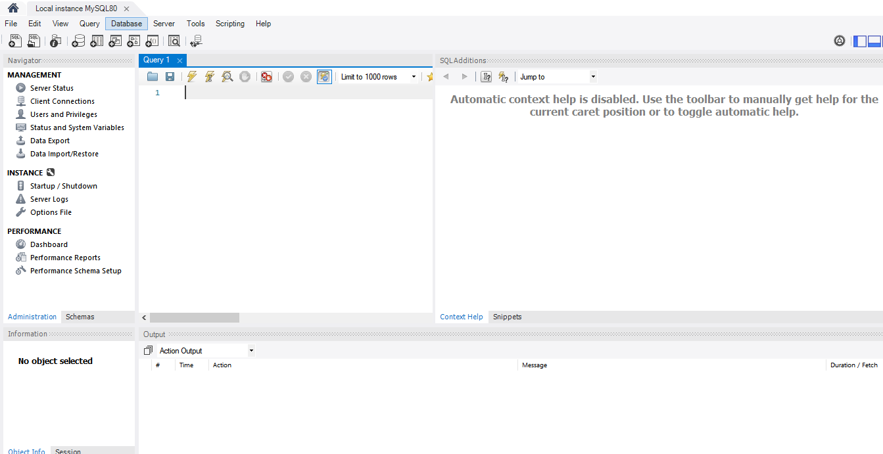
SQL Editor opens

Slide 45
Select Schemas Tab

Slide 46
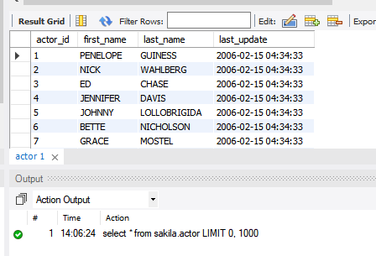
Write a Test Query and Execute it

Slide 47
Check out the Administration tab

Slide 48
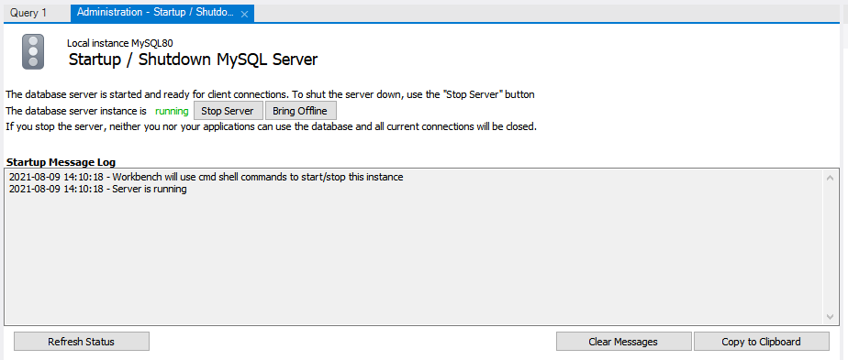
Startup/Shutdown the MySQL Server

Slide 49
When Done, close Connection Tab then choose Exit on the next screen

Slide 50
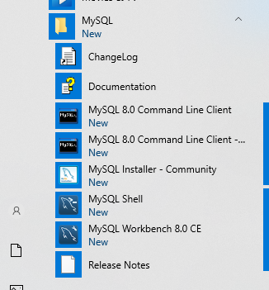
New Entries in Windows Start Menu

Slide 51
Select MySQL 8.0 Command Line Client

Slide 52
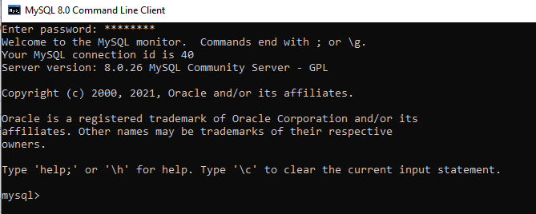
Enter password to get the ‘mysql’ prompt

Slide 53
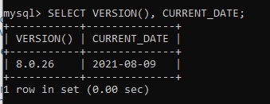
Check Version and Current Date

Slide 54
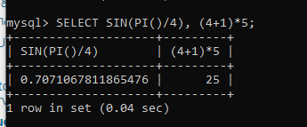
Use mysql as a simple calculator

Slide 55
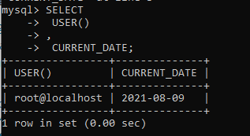
Simple multiple-line statement
Press Enter after each line

Slide 56

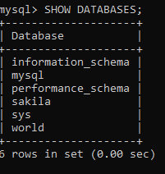

Creating and Using a Database
Use the SHOW statement to find out what databases currently exist on the server:
Your database needs to be created only once, but you must select it for use each time you begin a mysql session.

Slide 57



Creating a Table

Slide 58

Add a new record using an INSERT statement

Slide 59

Insert the following records into your table as in the previous slide
Observe that MySQL expects dates in 'YYYY-MM-DD' format; this may differ from what you are used to.
Use Null for missing values as hown in the previous slide.

Slide 60





The SELECT statement is used to pull information from a table.
The simplest form of SELECT retrieves everything from a table:
Selecting Particular Rows

Slide 61




Selecting Particular Columns
retrieve each unique output record just once by adding the keyword DISTINCT:

Slide 62



Sorting Rows

Slide 63

Use the Update Statement

Slide 64

Delete particular row

Slide 65

Empty the table
Once data has been deleted, it cannot be recovered, it is therefore strongly recommend make backups before deleting data.
Once data has been deleted, it cannot be recovered, it is therefore strongly recommend make backups before deleting data.

